Slide 1
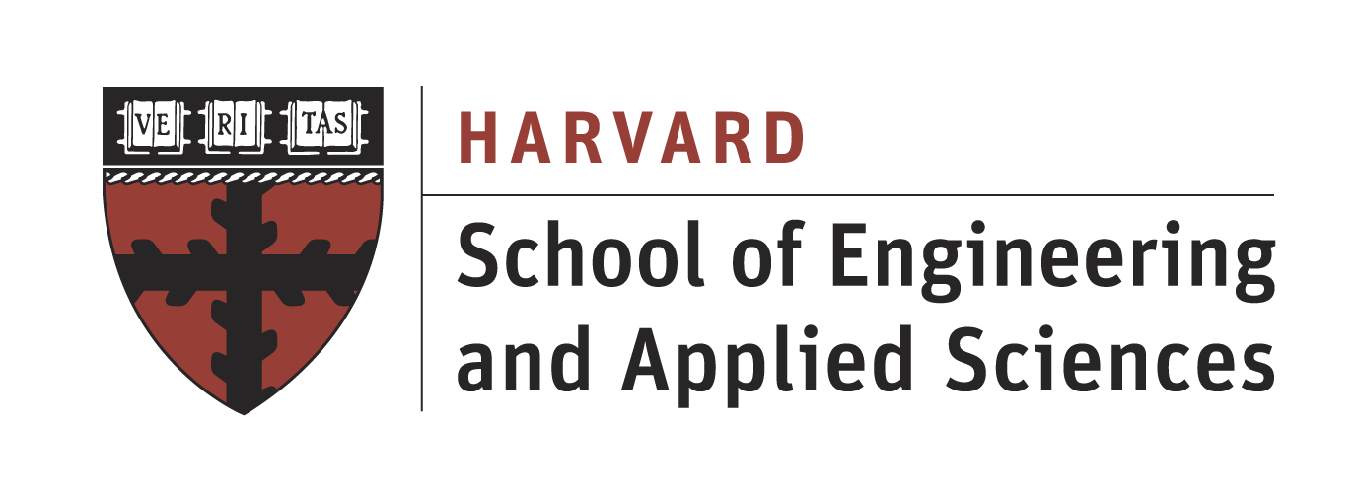

TRiCAM QRI Project Presentation
Understanding the Behavior of Oil Wells through Deep Learning
Presentation 1
Presenter: Akash Levy
This presentation: project description, how machine learning works, future steps
Project Members: Michelle Yang, Akash Levy, Janette Garcia, Albert Tung

Slide 2
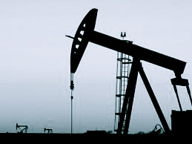
Introduction & Problem Statement
Project proposed by Quantum Reservoir Impact (QRI)
QRI: petroleum reservoir management company
Project goal: identify features in production data and forecast oil production rate in petroleum wells
Task 1: detect “events” (repairs, upgrades, other modifications to a well) = data mining
Task 2: forecast oil production rate with relative accuracy = machine learning
Strategy: use deep learning

Slide 3
Classical Prediction using Hard-coded Regression Modeling
Event detection (anonymized data)

Slide 4
Classical Prediction using Hard-coded Regression Modeling
Linear regressions for events, exponential decay otherwise

Slide 5

Problems with Hard-coded Modelling
Must be manually developed
Human bias/error involved
Not easily adaptable
Generally less scalable for larger data sets
Use machine learning instead!

Slide 6

deep learning?
What is it?
How does it work?
Why would we want to use it?

Slide 7
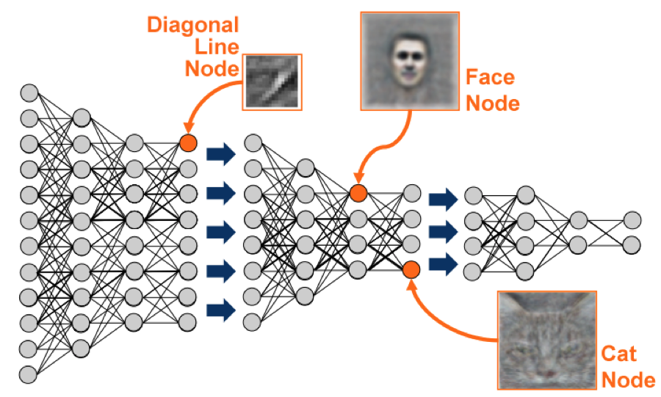
What is deep learning?
Deep learning:
Is a sophisticated form of machine learning
Applications include:
Speech recognition
Natural language processing
Stock market forecasting
Image recognition
(Google’s machine learning algorithm recognizes faces when applied to YouTube videos)

Slide 8
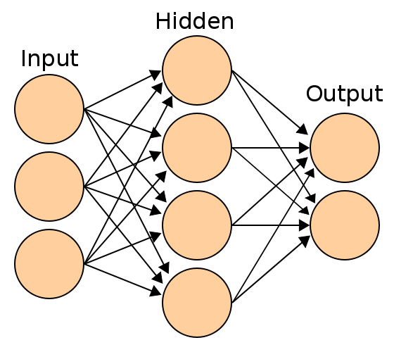
How does deep learning Work?
Deep learning involves the use of a neural network
Simple neural network layout:
Deep learning looks like this but consists of multiple hidden layers

Slide 9
How does deep learning Work?
Inputs
Weight
Sum
Activation Func.
Output
I₀
w₀
I₁
w₁
∑
σ(x)
O₀
A single neuron in a neural network:
w₂
I₂
Goal: adjust the weights to get as close as possible to the expected output
This is essentially the mathematical model of learning
Construction of representational model of information
Notes:
Explain each component

Slide 10
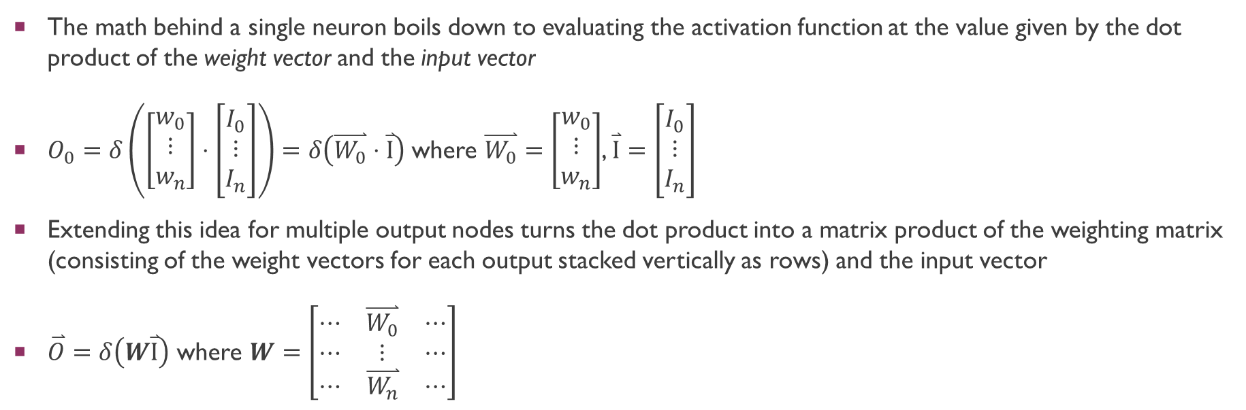
How does deep learning Work?
The math behind a single neuron boils down to evaluating the activation function at the value given by the dot product of the weight vector and the input vector
$O_{0}=δ\left(\left[\begin{matrix}w_{0} \\ ⋮ \\ w_{n}\end{matrix}\right]⋅\left[\begin{matrix}I_{0} \\ ⋮ \\ I_{n}\end{matrix}\right]\right)=δ\left(\overset{⃑}{W_{0}}⋅\overset{⃑}{I}\right)$ where $\overset{⃑}{W_{0}}=\left[\begin{matrix}w_{0} \\ ⋮ \\ w_{n}\end{matrix}\right]$, $\overset{⃑}{I}=\left[\begin{matrix}I_{0} \\ ⋮ \\ I_{n}\end{matrix}\right]$
Extending this idea for multiple output nodes turns the dot product into a matrix product of the weighting matrix (consisting of the weight vectors for each output stacked vertically as rows) and the input vector
$\overset{⃑}{O}=δ\left(W\overset{⃑}{I}\right)$ where $W=\left[\begin{matrix}⋯ & \overset{⃑}{W_{0}} & ⋯ \\ ⋯ & ⋮ & ⋯ \\ ⋯ & \overset{⃑}{W_{n}} & ⋯\end{matrix}\right]$

Slide 11
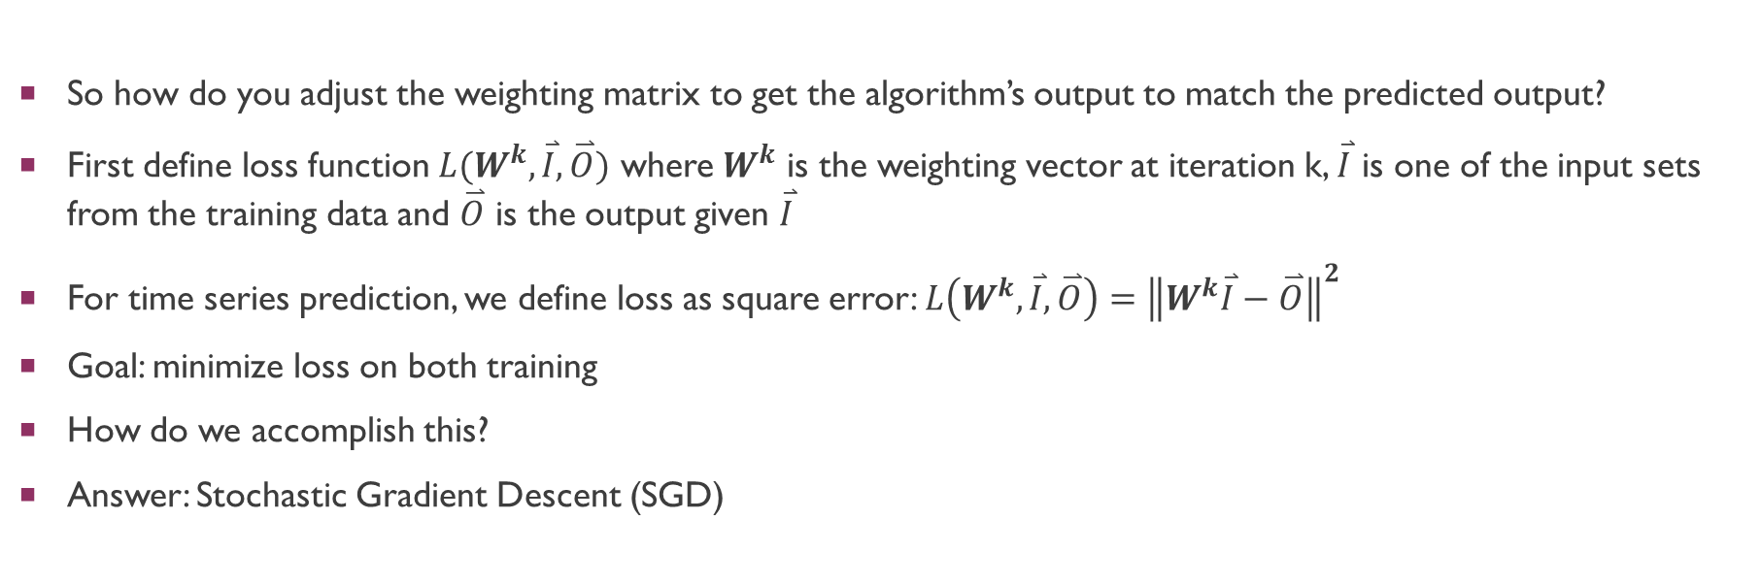
How does Deep Learning Work?
So how do you adjust the weighting matrix to get the algorithm’s output to match the predicted output?
First define loss function $L(W^{k},\overset{⃑}{I},\overset{⃑}{O})$ where $W^{k}$ is the weighting vector at iteration k, $\overset{⃑}{I}$ is one of the input sets from the training data and $\overset{⃑}{O}$ is the output given $\overset{⃑}{I}$
For time series prediction, we define loss as square error: $L\left(W^{k},\overset{⃑}{I},\overset{⃑}{O}\right)={\left\|W^{k}\overset{⃑}{I}−\overset{⃑}{O}\right\|}^{2}$
Goal: minimize loss on both training
How do we accomplish this?
Answer: Stochastic Gradient Descent (SGD)

Slide 12
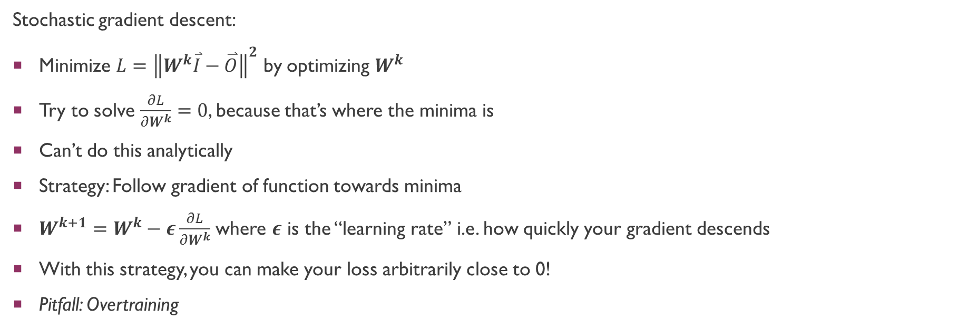
How does Deep Learning Work?
Stochastic gradient descent:
Minimize $L={\left\|W^{k}\overset{⃑}{I}−\overset{⃑}{O}\right\|}^{2}$ by optimizing $W^{k}$
Try to solve $\frac{∂L}{∂W^{k}}=0$, because that’s where the minima is
Can’t do this analytically
Strategy: Follow gradient of function towards minima
$W^{k+1}=W^{k}−ε\frac{∂L}{∂W^{k}}$ where $ε$ is the “learning rate” i.e. how quickly your gradient descends
With this strategy, you can make your loss arbitrarily close to 0!
Pitfall: Overtraining

Slide 13
How does Deep Learning Work?
Before discussing overtraining:
To do machine learning we have to split our data into training and validation sets
Train neural networks using training set
Test how well it works on novel input using validation set
QRI holds the third data set, testing set, which contains predictions for the wells at future dates

Slide 14
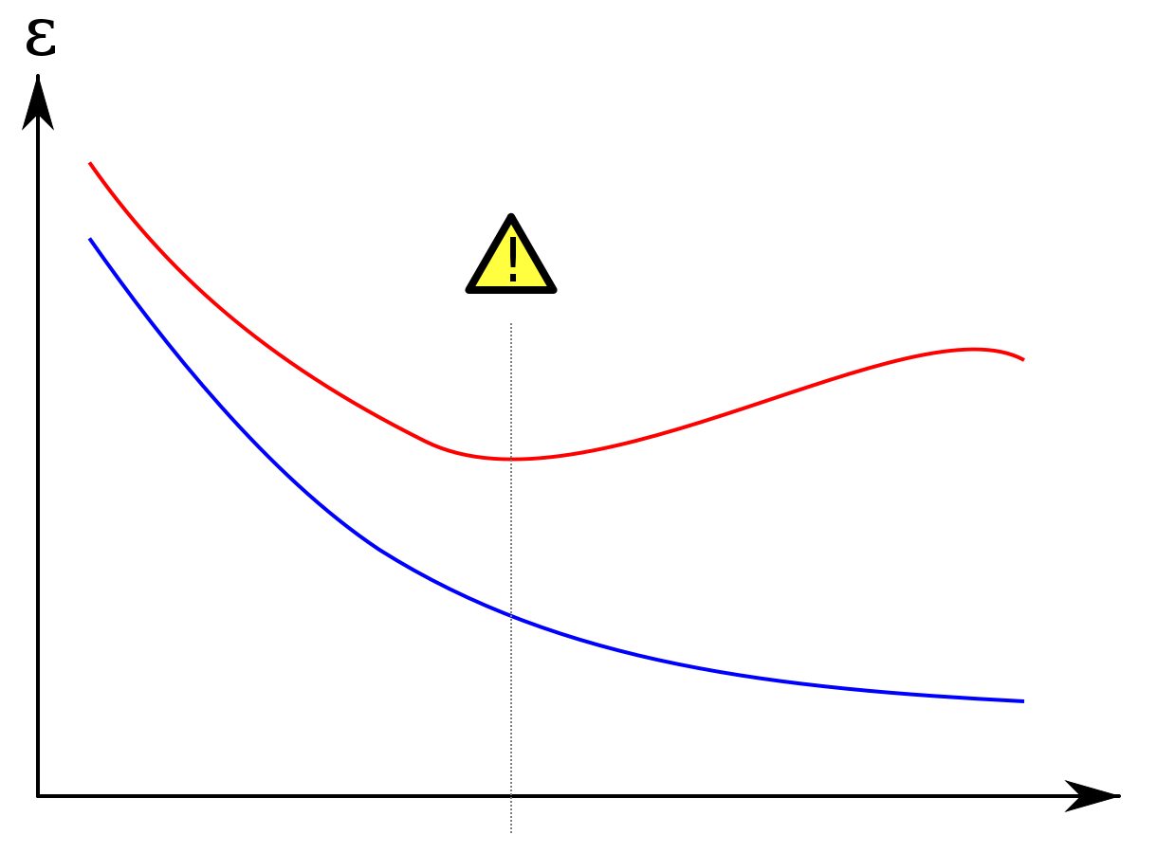
How does Deep Learning Work?
Error
Validation Set
Overtraining: after a certain number of training steps, you continue to get better predictions for your training set but not for your validation set
Training Set
Training Steps

Slide 15
Why use deep learning?
Deep Learning
Performance
Most ML algorithms
Amount of data
Notes:
Works well with larger data sets!

Slide 16
Implementations Explored
Theano: Python toolkit for running computations quickly on GPUs
Scikit-learn: Python library for machine learning
Pylearn2: Python library for machine learning (buggy, still in active development)
NuPIC (Numenta Platform for Intelligent Computing): Python library implementing HTM deep learning algorithm developed by Numenta
More on Theano in future presentations!

Slide 17
Deep Learning Architectures
Implementation:
Many, many different kinds of implementations
We have decided to use Theano and are learning the basics of it currently
We will be focusing on:
Autoencoders
Restricted Boltzmann Machines (RBMs)
Convolutional Neural Networks (CNNs)
Recurrent Neural Networks (RNNs)
More on these implementations in future presentations!
If time permits:
Hierarchical Temporal Memory (HTM)

Slide 18
Next Time:
Thank you!
Questions?
More on specific implementations of deep learning
More on Theano

